Slide 1

Hello there!
Social Networking & the MLSA Program.
Anisha Mohanty

Slide 2
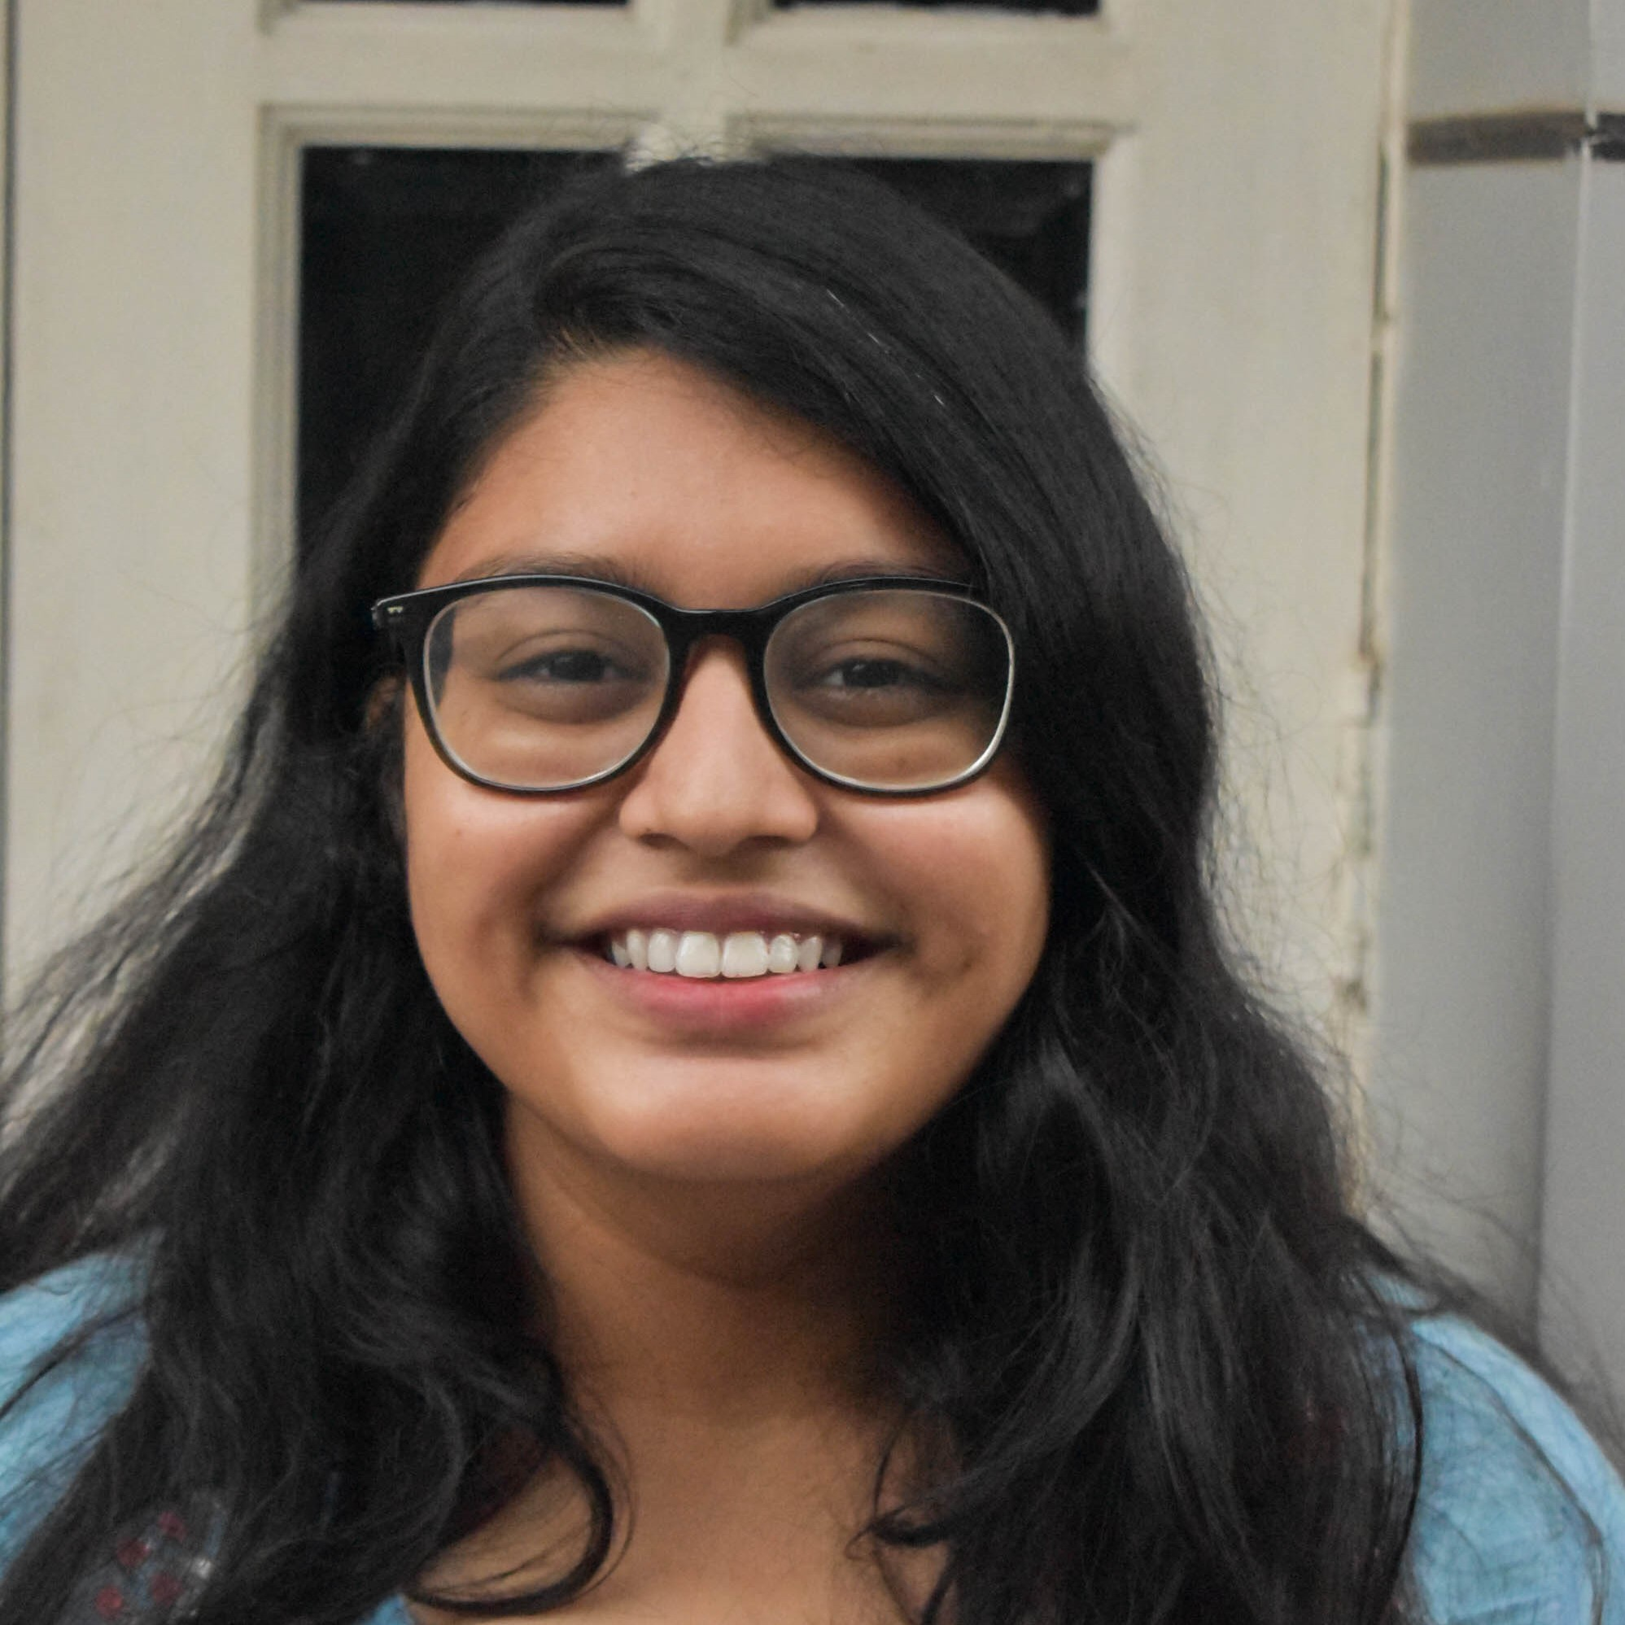


CSE Student at SRM University
Club Secretary for MLSA SRM & SRMpedia
Design and Marketing Enthusiast Beta Microsoft Learn Student Ambassador
.
.
.
.
Meme enthusiast!

Slide 3

What is ‘Social’ Networking?
And why is it truly important?

Slide 4
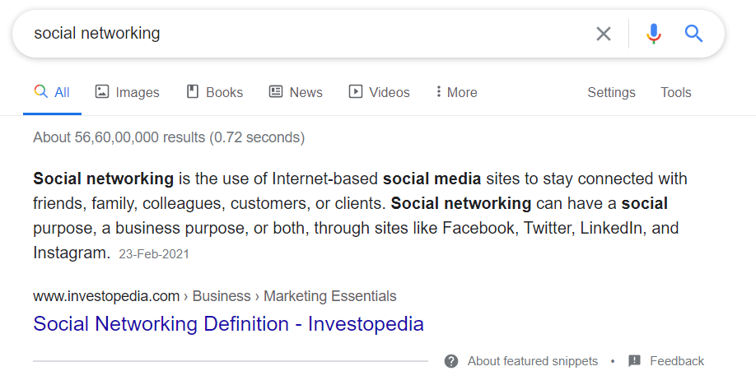
Let’s ask everyone’s favourite search engine!

Slide 5

Social Networking

Slide 6

How is ‘Professional’ Networking different?
And why should we practice it?

Slide 7

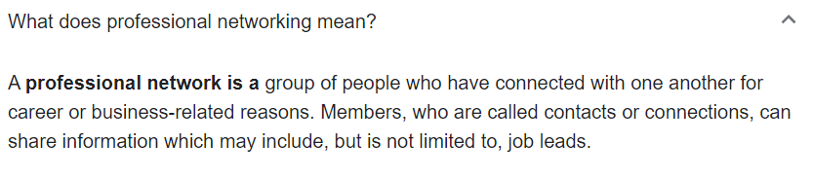
Let’s get the literal definition down.

Slide 8


Who’s the master of it all then?

Slide 9
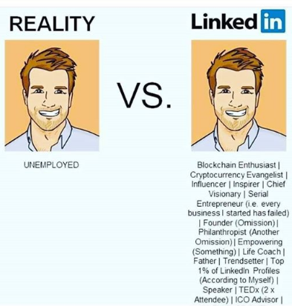
Reality is pretty different from expectations.
Is this necessarily bad though?

Slide 10
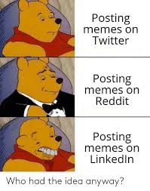
‘Appropriate’ is just a tag. Or is it?

Slide 11
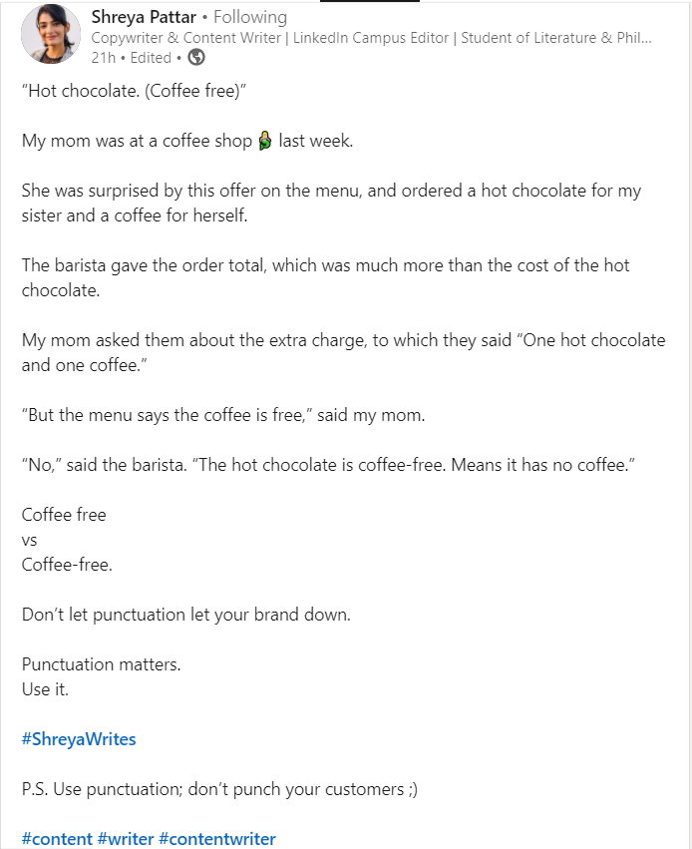
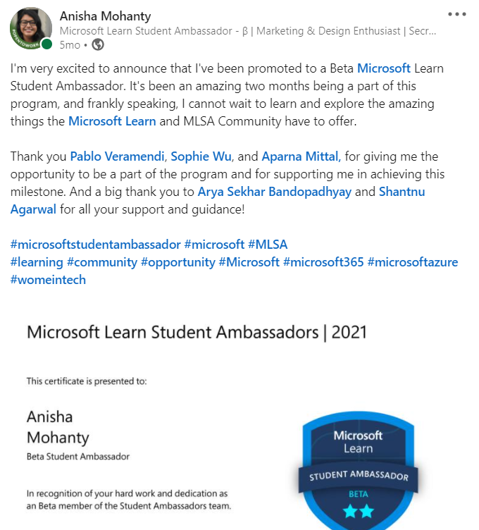
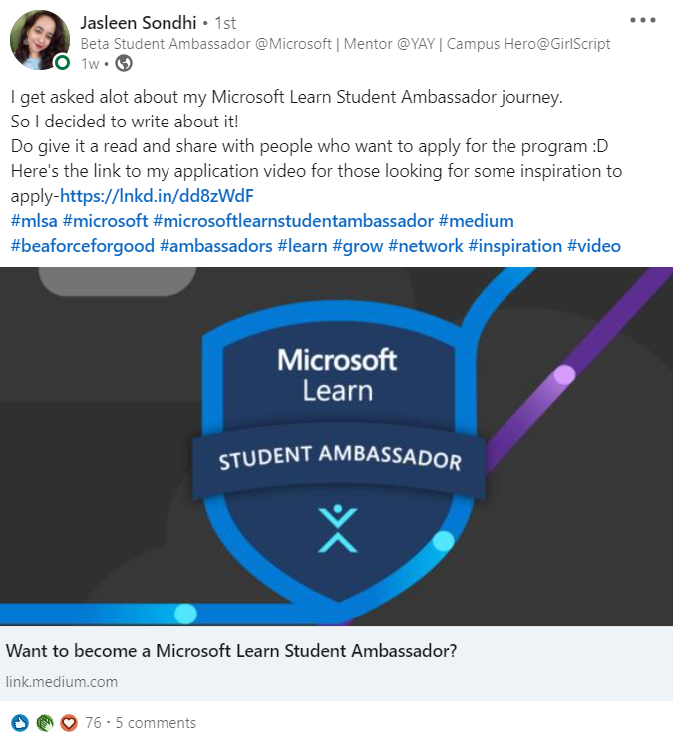
What should you be making posts about? A beginner’s guide.

Slide 12
Hashtags are your #friends!

Slide 13
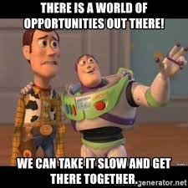
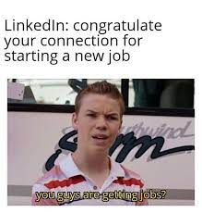
Is that all?

Slide 14
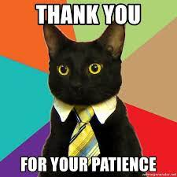
Thank you!

